Slide 1
Unit 1 Week 1 Session 4
Vendor Qualification
Learn String Manipulation by Building a Cipher

Slide 2
Learning Outcomes
By the end of the course you will be able to:
Use python to develop a program
Learn the basic programming concepts such as variables, functions, loops and conditional statements.

Slide 3
This session will be hands on using String Manipulation by Building a Cipher IDE.

Slide 4
Overview: “String Manipulation by Building a Cipher ” by FreeCodeCamp
Python is a powerful and popular programming language widely used for data science, data visualisation, web development, game development, machine learning and more.
In this project, you'll learn fundamental programming concepts in Python, such as variables, functions, loops, and conditional statements. You'll use these to code your first programs.

Slide 5
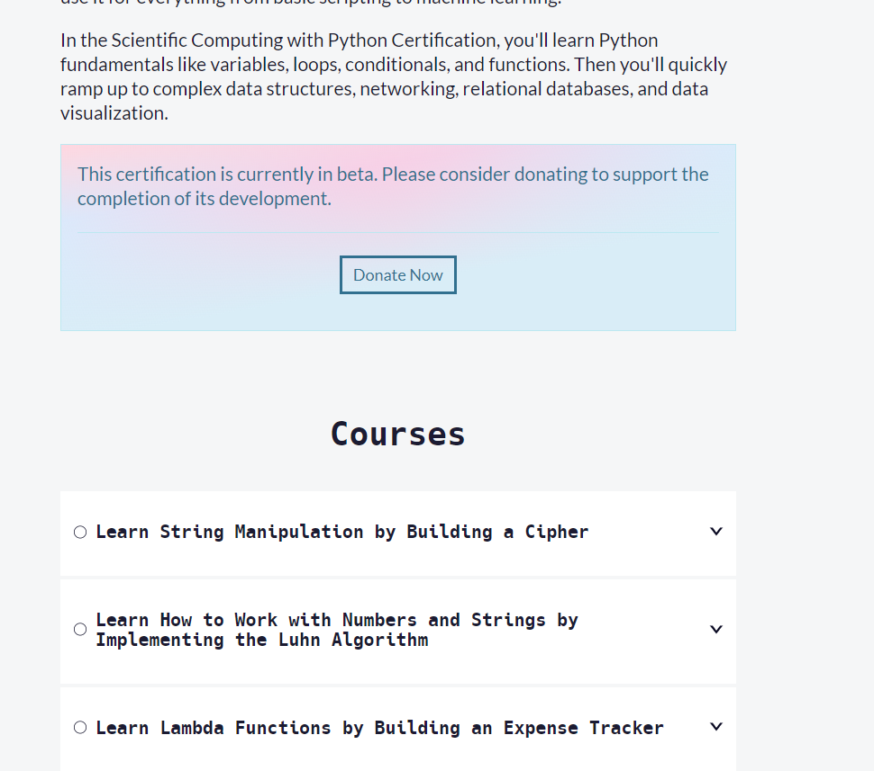
Continue….
Notes:
Please provide the following link to learners to start the Learn String Manipulation by Building a Cipher project: https://www.freecodecamp.org/learn/scientific-computing-with-python/

Slide 6
Any questions?
Please ask if you get stuck. Feel free to collaborate and help each other
Skills for All frequently asked questions can be found at https://www.freecodecamp.org/news/about/, or by clicking Help in the top navigation bar.
Notes:
https://www.freecodecamp.org/news/about/

Slide 7
Learning Outcomes
Now you will be able to:
Use python to develop a program
Learn the basic programming concepts such as variables, functions, loops and conditional statements.

Slide 8
Any Questions?
Thank you!

